Slide 1
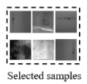

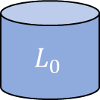
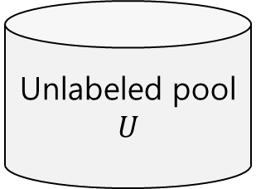
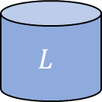
$${ L}_{0}$$
Labeled
Training set
Initial Training
Or Pre-training
Unlabeled pool
$$U$$
Semi-supervised
Learning
Deep learning model
pseudo
Batch
Labeling
Sampling
Update dataset
Training model
$$L$$
Labeled
Training set

Slide 2
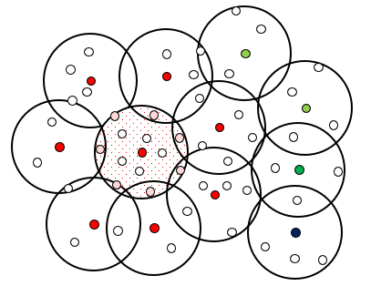
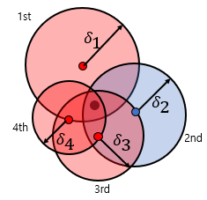



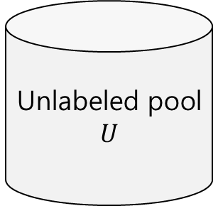






<Original dimension>
Label data $N_{l}$
Pseudo Label data($N_{CS1}+N_{CS2})$
1st CS1 Original Data
Unlabeled pool
$$U$$
${|S}^{1}|$
.
.
.
.
.
.
Deep learning
Model
ith CS1 Original Data
Training
${|S}^{i}|$
.
.
.
.
.
.
Pth CS1 Original Data
${|S}^{P}|$
CS2 Original Data
Feature
Extraction
CS1
CS2
${|S}^{1}|$
Feature of $U$
Coreset
selection
.
.
.
${|S}^{i}|$
P Iteration
.
.
.
${|S}^{P}|$
<Feature dimension>

